Slide 1
Data Science for CSC/CIT 1105-01 Spring 2022 Dr. Kanampiu
What is Data Science?

Slide 2
Data Science
Fundamentally, "science" is about formalizing a hypothesis given a reasonable set of observations and assumptions, designing an experiment around that hypothesis, testing it and analyzing the data generated through that process to either confirm or falsify the hypothesis.
Therefore, "data" is simply a natural byproduct of science. Very (very) rarely are things labeled as data science actually scientific.
Rather, data science most often refers to the tools and methods used to analyze large amounts of data.
As such, the discipline is an amalgamation of many bits from other areas of research (e.g., Computer Science, Statistics).

Slide 3
Our Objectives
Our objectives?
Understand the subject of data science
Data scraping
Reading data
Creating data objects
Visualization using Jupyter notebook/google colab
Discovering data correlations

Slide 4
Data Scraping: Data acquisition
Data has to be collected first
Data scraping, also known as web scraping, is the process of importing information from a website into a spreadsheet or local file saved on your computer. It’s one of the most efficient ways to get data from the web

Slide 5
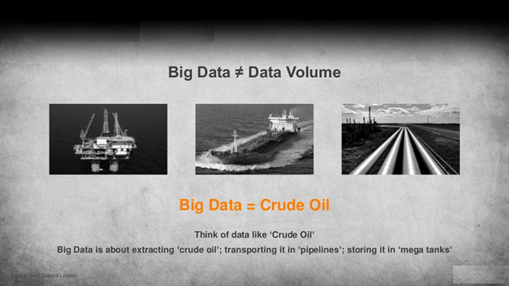
Raw big data is useless

Slide 6
Data cleaning/hygiene
Accurate
up-to-date (inconsistencies or error = flawed results=wrong decisions = life and death (in health for example)
What to do:
Get rid of unwanted (irrelevant) observations (Those that don’t fit the problem you’re looking to solve)
Fix structural errors
Structural errors usually emerge as a result of poor data housekeeping. They include things like typos and inconsistent capitalization, and misspellings which often occur during manual data entry. E.g., Iron vs iron for metals will be read different.
Solution = standardize your data (e.g., decide whether values should be all lowercase or all uppercase, numerical data use the same unit of measurement, date formats etc.)
Remove unwanted outliers
data points that dramatically differ from others in the set ( These can skew a linear regression model, BUT only remove if you can prove that it is erroneous, e.g., if it is obviously due to incorrect data entry, or if it doesn’t match a comparison ‘gold standard’ dataset.
4. Fix contradictory data errors (Errors are where you have a full record containing inconsistent or incompatible data, E.g., a pupil’s grade score being associated with a field that only allows options for ‘pass’ and ‘fail’, or an employee’s taxes)

Slide 7
Deal with missing Data
remove the entries associated with the missing data.(can lose other important information )
impute (or guess) the missing data, based on other, similar data
Flag the data as missing (most common?)
<To do this, ensure that empty fields have the same value, e.g. ‘missing’ or ‘0’ (if it’s a numerical field). Then, when you carry out your analysis, you’ll at least be taking into account that data is missing, which in itself can be informative.>

Slide 8
Validate your dataset
Validating data means checking that the process of making corrections, deduping, standardizing (and so on) is complete. This often involves using scripts that check whether or not the dataset agrees with validation rules (or ‘check routines’) that you have predefined. You can also carry out validation against existing, ‘gold standard’ datasets. This all sounds a bit technical, but all you really need to know at this stage is that validation means checking the data is ready for analysis.

Slide 9
Representing Data Visually (Visualization)
Converting raw data to a form that is viewable and understandable to humans
Using data visualizations can be a great way of spotting errors in your dataset. For instance, a bar plot is excellent for visualizing unique values and might help you spot a category that has been labeled in multiple different ways (like our example of ‘Colab…Lab 2). Likewise, scatter graphs can help spot outliers so that you can investigate them more closely (and remove them if needed).

Slide 10
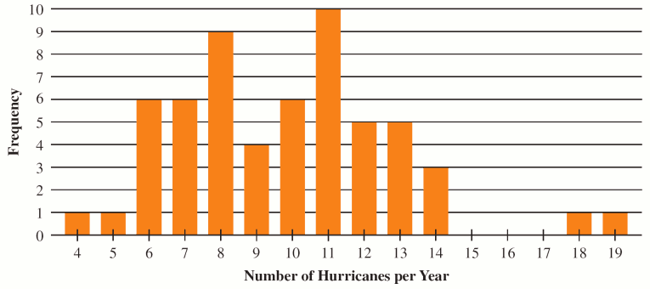
The bar graph shows the number of Atlantic hurricanes over a period of years.

Slide 11
END
Q&A/Comments

